Slide 1
Deep Learning based cotton plant pest detection and Fertilizer recommendation System.
Team Details(Batch – 21) :
D. Manoj Kumar – 20761A0577
S. Sai Manikanta – 20761A05B8
Sk. Mahira – 20761A05B9
Guide :
Dr. M. Sitha Ram
Associate Professor

Slide 2
CONTENTS
Abstract
Introduction
Literature Survey
Design
Code
Implementation
Output
Conclusion
Paper Status
References

Slide 3
ABSTRACT
In agriculture, Pests are the major reason that causes low yield, which greatly affects the crop. Cotton plays a major role in the textile industry and due to a lack of pest identification more amount of cotton crops are getting damaged, to solve this problem Convolutional neural networks along with MobilenetV2 is used to detect the pests in the cotton plant by passing an RGB image to the model and the model detects whether the pest is present in the crop or not with the accuracy rate of 97.74%. If the pest is present then the farmer has to be ready with pesticide and if the pest is not present the farmer has to give fertilizer based on soil properties this can be done by using the Random Forest algorithm with an accuracy of 97.95%. This can help farmers to produce more yield

Slide 4
INTRODUCTION
Cotton cultivation plays a pivotal role in the global textile industry, and its success is closely tied to effective crop management. In the Krishna region, where cotton farming is a prominent agricultural activity, farmers face significant challenges related to pest infestations and fertilizer management. To address these issues, our project proposes an integrated system that leverages modern technology, data analytics, and machine learning. By collecting and analyzing data on soil properties, crop images, and weather conditions, we aim to provide farmers with real-time pest detection and precise fertilizer recommendations. The goal is to enhance cotton crop yields, reduce environmental impact, and promote sustainable agricultural practices in the Krishna region. This project represents a crucial step towards modernizing and optimizing cotton farming in this important agricultural hub.

Slide 5
Literature Survey
Paper | Authors | Year | Model | Accuracy
Deep Learning-Based Image Processing for Cotton Leaf Disease and Pest Diagnosis | Azath M., Melese Zekiwos, and Abey Bruck | 2021 | Basic CNN Framework | 96.40%
Cotton pests classification in field-based images using deep residual networks | Adão Nunes Alvesa , Witenberg S.R. Souzaa , Díbio Leandro Borges | 2020 | ResNet34 | 97.8%
Pest Classification and Pesticide Recommendation System | Myat Mon Kyaw, San San Nwe, Myint Myint Yee | 2019 | AlexNet | Error Rate : 3.57%

Slide 6
Literature Survey
Paper | Authors | Year | Model | Accuracy
Insect classification and detection in field crops using modern machine learning techniques | Thenmozhi Kasinathan, Dakshayani Singaraju, Srinivasulu Reddy Uyyala | 2020 | SVM Classifier | 75.8%
Crop Diseases and Pests Detection Using Convolutional Neural Network | Patel and Vaghela | 2021 | Proposed method with basic cnn architecture using transfer learning approach.
Intelligent insecticide and fertilizer recommendation system based on TPF-CNN for smart farming | Tanmay Thorat, B.K.Patle, Sunil kumar | 2022 | TPF-CNN | 91%

Slide 7
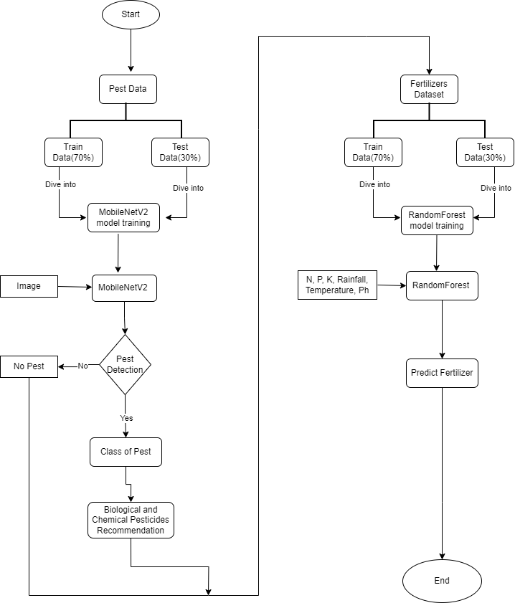
Design

Slide 8
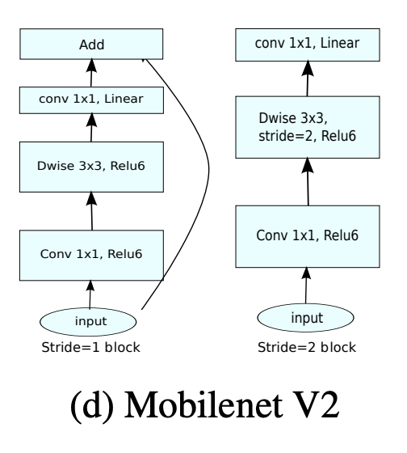
Architecture

Slide 9
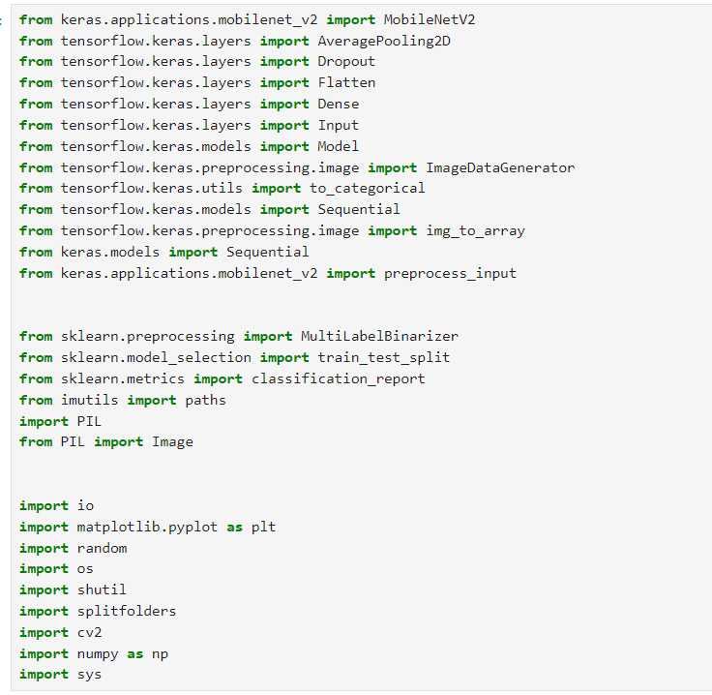
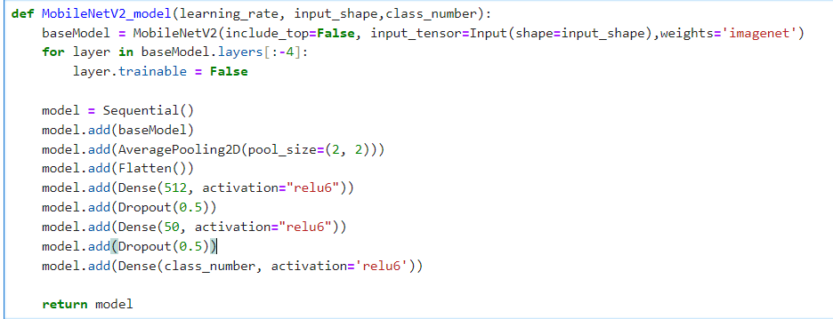
Code
Libraries used :
Model :

Slide 10
Dataset Description:
Combined images from different datasets of pests that commonly affect cotton.
Pest Dataset(5 classes) :
Aphids – 2665
Black cutworms - 483
Bollworms - 501
Fall armyworms - 1189
Thrips - 154
Format : jpg
Source : Kaggle

Slide 11
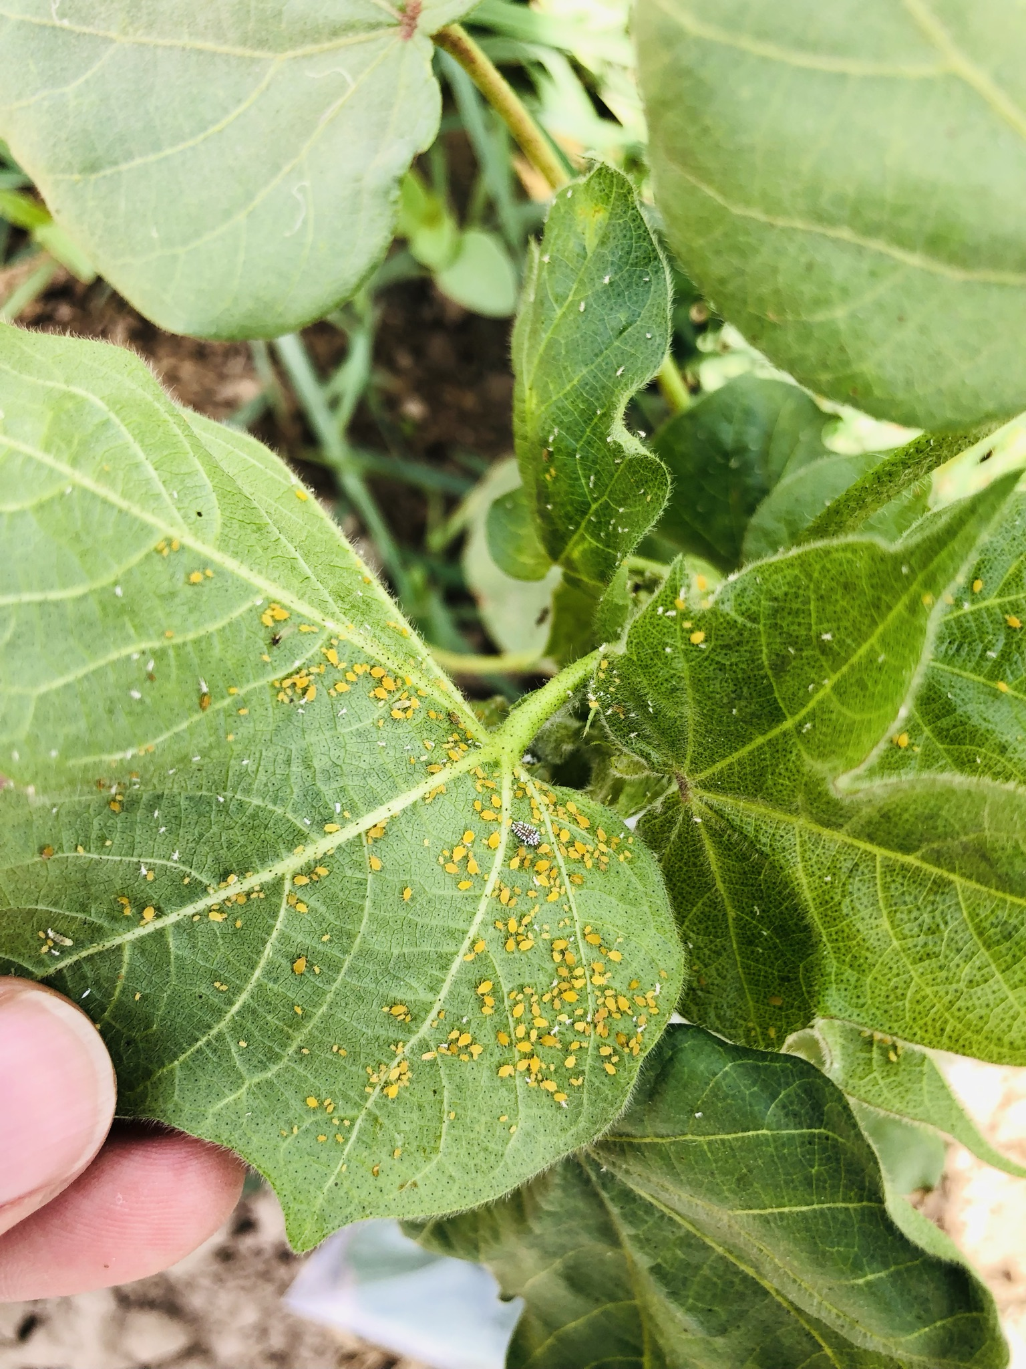
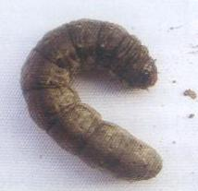
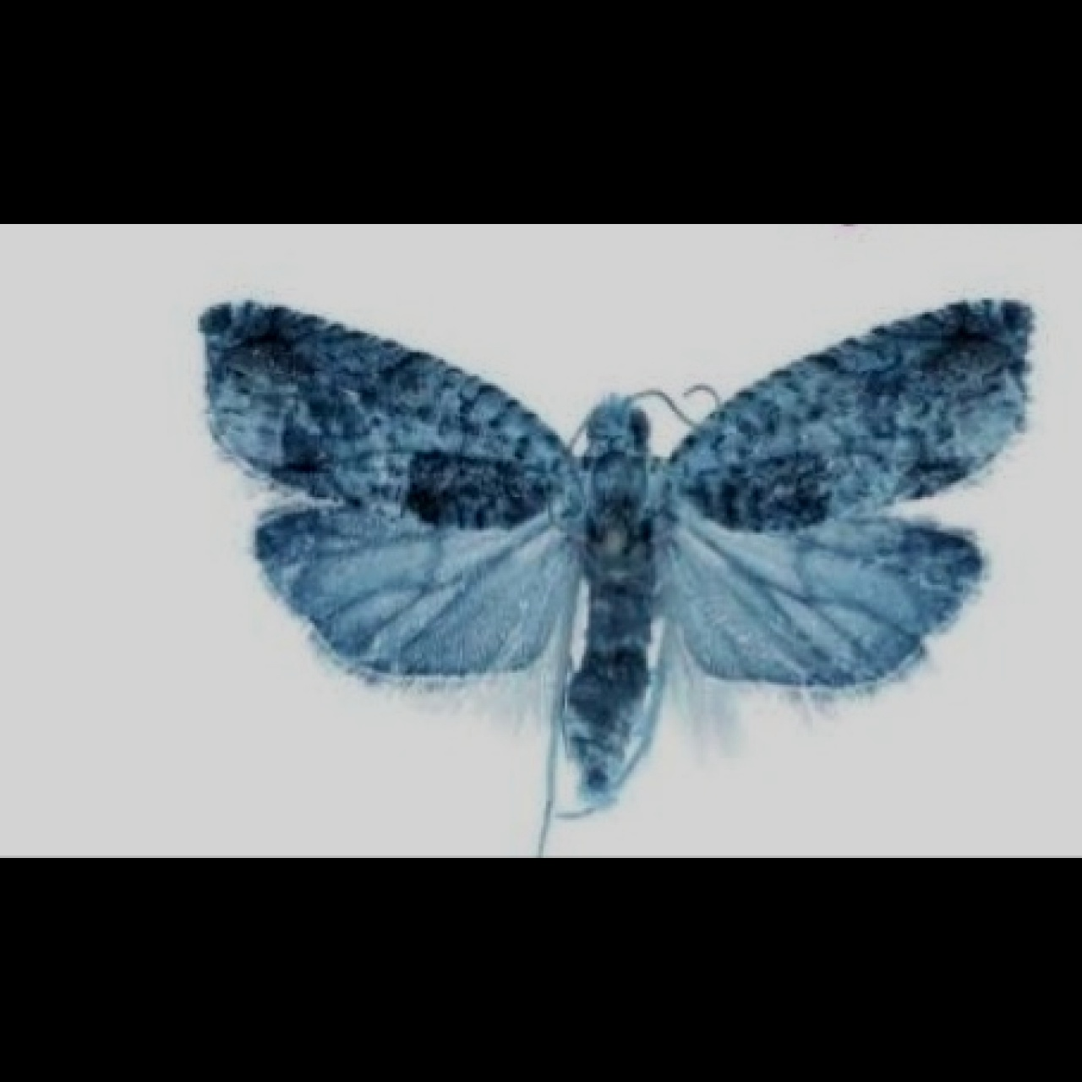
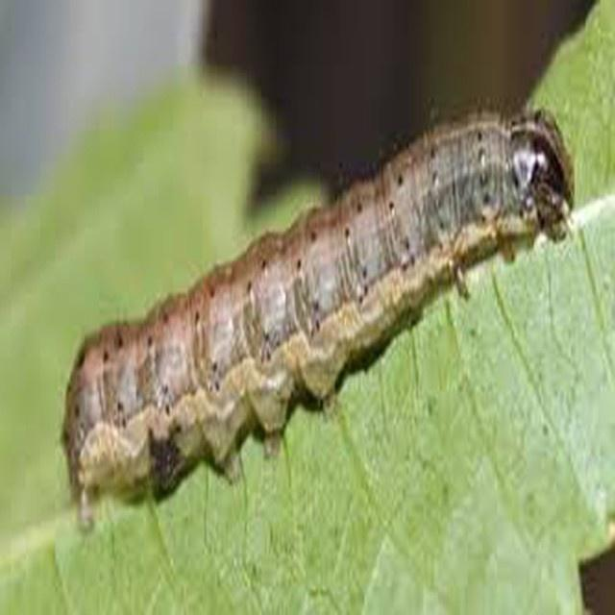
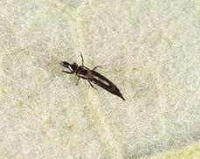
Sample images
Aphids
Black cutworms
Bollworms
Fall armyworm
Thrips

Slide 12
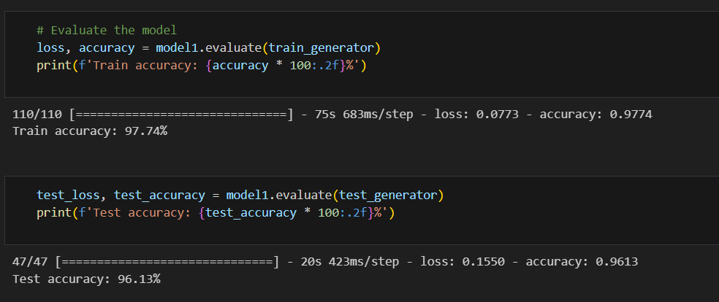
Implementation

Slide 13
Comparation among all the models
S.No | Model | Accuracy
1. | MobileNetV2 | 97.74%
2. | Vgg-16 | 87.92%
3. | ResNet50 | 53.94%
4. | RandomForest | 97.95%
5. | KNN | 59.50%

Slide 14
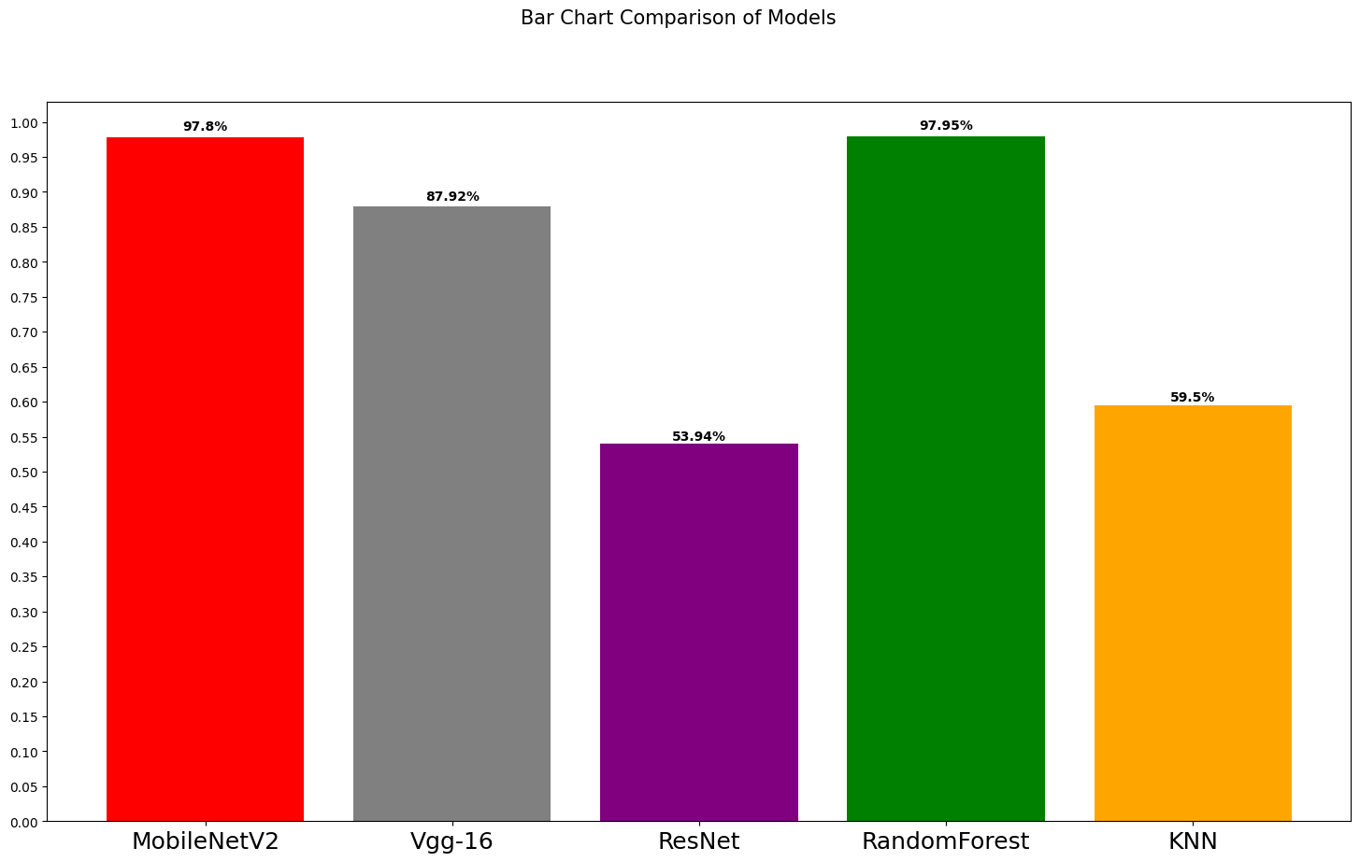
Accuracy Comparision among all models

Slide 15
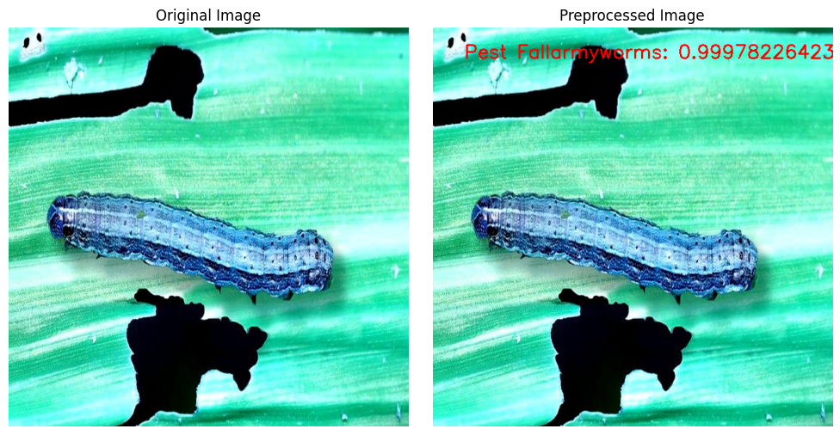
Output

Slide 16
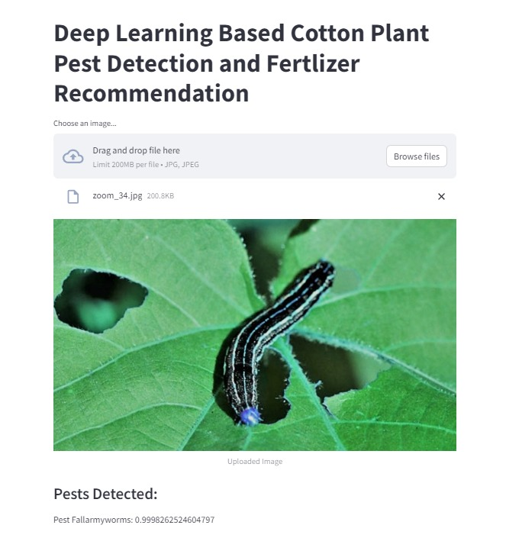
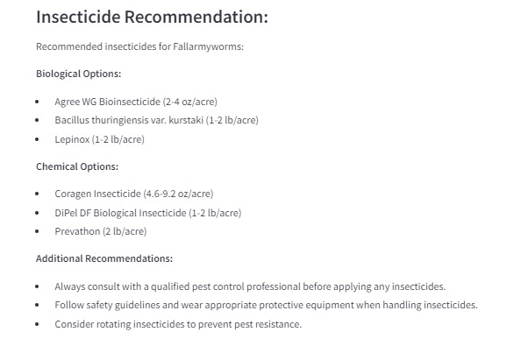
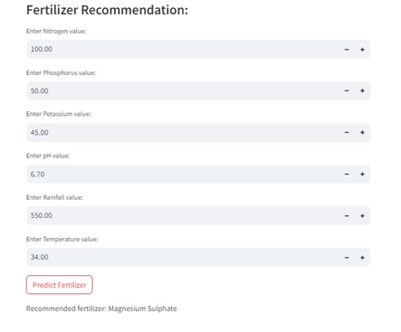
Frontend Slides

Slide 17
Conclusion
In conclusion, our initiative tackles the important problem of low output in agriculture caused by pests, with a special emphasis on cotton crops. Utilizing RGB pictures and convolutional neural networks (CNN) in combination with mobilenetv2, we have created a successful method for detecting pests in cotton plants. With an astounding 96.31% accuracy rate, the model allowed for quick detection of pest infestation. We then included the random forest algorithm to decide on pest management strategies. Farmers are encouraged to use pesticides when pests are found and to apply fertilizers according to the characteristics of the soil when pests are not present. The random forest algorithm improved the accuracy of fertilizer application with a high accuracy of 97.95%. Farmers may take targeted and timely action by using this two-step technique, which provides them with a useful and accurate tool. In the end, we want to help farmers maximize crop productivity by efficiently handling pest-related issues.

Slide 18
References
Cotton pests classification in field-based images using deep residual networks - Adão Nunes Alvesa , Witenberg S.R. Souzaa , Díbio Leandro Borges
Crop Diseases and Pests Detection Using Convolutional Neural Network - Pruthvi P. Patel, Dineshkumar B. Vaghela
Deep Learning-Based Image Processing for Cotton Leaf Disease and Pest Diagnosis - Azath M. , Melese Zekiwos,Abey Bruck
Prediction of crop yield and fertilizer recommendation using machine learning algorithms - Devdatta A. Bondre, Mr. Santosh Mahagaonkar
Intelligent insecticide and fertilizer recommendation system based on TPF-CNN for smart farming - Tanmay Thorat , B.K. Patle , Sunil Kumar Kashyap

Slide 19
References
American bollworm and pink bollworm - https://www.kaggle.com/datasets/hatemamine/1280bollworm
Ip102 - https://www.kaggle.com/datasets/rahimanshu/pest-classification-ip102-dataset/data
Fall armyworm - https://www.kaggle.com/datasets/shruthi11sivagnanam/fall-armyworm
https://www.kaggle.com/code/nainikagaur/mobilenet-v2-implementation

Slide 20
Paper Status
Writing Paper completed and has been submited for journal named IAES International Journal of Artificial Intelligence (IJ-AI).

Slide 21
Thank you

